Slide 1
Chapter 5
Input and Output

Slide 2
List of contents
Output Statements
The print() statement
The print(‘string’) statement
The print(variable list) statement
The print(object) statement
The print(“string”, variables list) statement
The print(formatted string) statement
Input statements
Command line arguments
Parsing command line arguments

Slide 3
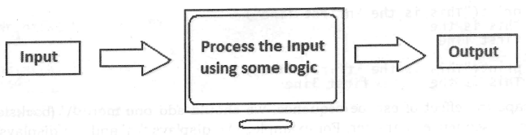
Introduction
The purpose of a computer is to process data and return results.
It means that first of all, we should provide data to the computer.
The data given to the computer is called input
The results returned by the computer are called output

Slide 4
Go to Jupyter notebook for examples

Slide 5
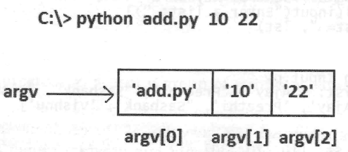
Command line arguments
Command line arguments are passed to the program from outside the program.
All arguments should be entered from the keyboard separating them by as space
These arguments are stored by default in the form of strings in a list with the name ‘argv’ which is available in sys module
Since ‘argv’ is a list that contains all the values passed to the program, argv[0] represents the name of the program, argv[1] represents to the first value, argv[2] represents the second value and so on
For example:

Slide 6
Parsing command line arguments:
The argparse module in python is useful to develop user-friendly programs using command line arguments.
The argparse module automatically generates help and usage of massages when user gives the program invalid arguments.
It also displays appropriate error messages to the users

